Slide 1
NAO Final Sprint Review
C1C Christian Arnold
C1C Casey Born
C1C Adrian Chiriac
C1C Colin Schnoes
C1C Jacob Taylor

Slide 2
Project Goals
The overall goal of this project is to create a platform for STEM outreach using the Nao robots that focuses on K-5 students in the Colorado Springs area.

Slide 3
Product Backlog Items
From This Semester
STEM Demo | Functional
Fix the High-Low Game | Functional
Explore Capabilities | Forever Ongoing
Program stand-alone animations | Functional
Develop Animated Emotional Responses | Functional
Programs for Special Needs Children | Functional
Fix Rock-Paper-Scissors Game | Functional
Program Nao to control a BB-8 | Functional

Slide 4
Product Backlog Items
For Next Semester
Enhance RPS with visual recognition | Nonfunctional
Locate and Walk towards voice | Nonfunctional
Fix 20 Questions Game | Nonfunctional
Demonstrate Asimov’s Three Laws of Robotics | Not Feasible
Visual Sensory Environment Perception | Nonfunctional
Choregraphe module for use by children | Nonfunctional
Basic Math SKills Game | Nonfunctional
Numeric Ordering Game | Nonfunctional
Foreign Language Conversations | Nonfunctional
Foreign Language Counting | Nonfunctional
Basic Factual Knowledge Game | Nonfunctional

Slide 5
Details on PBIs From This Semester
As a K-5 STEM Supporter, I need the NAO to engage with my students in activities and demos that would encourage their interests in STEM studies and careers so that they will be excited, motivated, and not intimidated to further their studies in STEM subjects to include computer science and robotics.
Numerous demos complete, tested, and ready for release
Always looking for new ideas and opportunities
As a STEM Supporter, I need the NAO to play the High-Low game with students in an age-appropriate conversational manner (K-5, 6-8, 9-12) to help develop number understanding and algorithmic reasoning skills (bisection searching) so that the students are motivated for further studies of computer science.
Ready for Demonstration
Needs to be monitored for issues.

Slide 6
Details on PBIs From This Semester
As a Developer for the NAO, I need the NAO to perform animated emotional responses (with or without speaking) to indicate surprise, thinking/pondering, happy, sad, excited, 'whatever' attitude, 'What'z up?', and other similar emotions.
Several emotions complete and integrated into demos
Looking for more ideas and opportunities
As a Special Needs K-5 Educator, I need the NAO to say (in an animated manner), "Uh, I am upset right now. May I have a break, please" so that the student will understand that it is okay to feel upset and ask for a break.
Couple of demos complete
Need more thorough testing with teachers and some kids

Slide 7
Sprint 3 Retrospective Meeting
Good
Met all objectives in estimated time
Solid work distribution
Better teamwork and communication
Great demo with kids that provided feedback
Bad
Robot issues during demo
Demoed the wrong things to the kids
Rushed Sprint Review Presentation

Slide 8
Sprint 4 Tasks
Report In Animation (2 hrs)
Develop presentation plan (4 hrs)
Investigate and fix issues from demo (14 hrs)
Voice Standardization (4 hrs)
RPS prompt change “I have ____ ….” (2 hrs)
Fix “Chicken Thrusts” (4 hrs)
Victory poses on win (4 hrs)
Code simplification (12 hrs)
Cheers (4 hrs)
Add changes to demo (2 hrs)

Slide 9
Design Model
System architecture
Choregraphe
Nao Robot
BB8
Force Band

Slide 10
Key Design Decisions
What to do?
Many small decisions
Limited by capability of the robot
Affected by the intended audience

Slide 11
Demo

Slide 12
Summary and Takeaways
Accomplished many of our goals
Gained a solid understanding of Nao robots
Created a (hopefully) great demo for the kids
Figured out a system which fosters efficient work distribution and productivity

Slide 13
Documentation
University of Notre Dame F.U.N. Lab

Slide 14
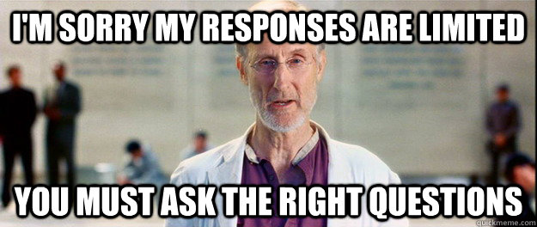
Questions?

